Slide 1
Finding a good location to open an Italian restaurant in Berlin, Germany
Final Assignment for IBM Data Science Coursera Specialization
Erin Bedri
18.05.2020

Slide 2
Background
Capital and largest city in Germany;
World city of culture, politics, media, and science;
Over 28 million overnights;
Over 11 million hotel guests;
Ranked 13th in the Quality of living ranking.

Slide 3
Problem
Wide variety in the gastronomy sector;
Searching for an optimal location is challenging:
Customers tend to prefer popular and busy neighborhoods;
Resuting in higher rents and stronger competition for investors.
Interest: the project would be interesting for investors who want to open a new Italian restaurant in Berlin.

Slide 4
Data Description
The following data will be searched for and considered during the project:
a) Number of already existing Italian restaurants in a given borough; b) Different boroughs and their respective average rental prices to open a restaurant;
Additionally, the tools that will be used in this project are:
a) Foursquare API to select the number of Italian restaurants and their respective location in any given borough in Berlin; b) Geocoder to get the latitudes and longitudes of places of interest.

Slide 5
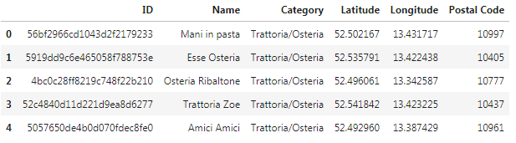
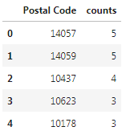
Methodology
Figure 1: The main dataset created using the Foursquare API exploring all Italian restaurants in Berlin, Germany.
Figure 2: Dataset exploring all Italian restaurants and their total count

Slide 6
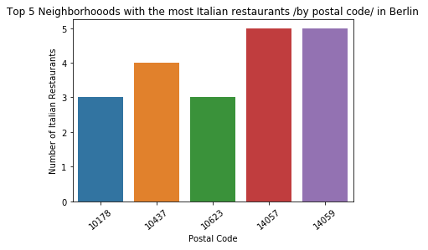
Results

Slide 7
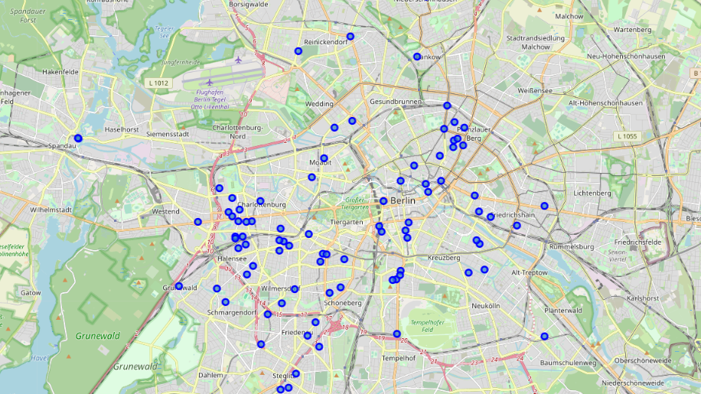
Results, cont.

Slide 8
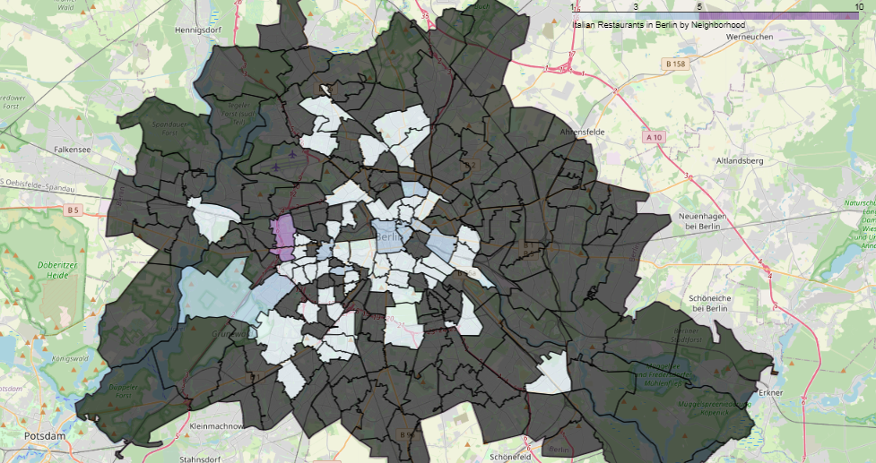
Results, cont.

Slide 9
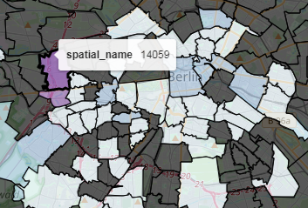
Results, cont.
Figure 3: A zoomed in choropleth map showing the most populous neighborhood with Italian restaurants in Berlin.

Slide 10
Conclusion
There are a total of 92 Italian restaurants in Berlin;
54 neighborhoods in Berlin have Italian restaurants;
2 of those have at least 5 Italian restaurants;
1 has 4 restaurants.

